Slide 1
OpenCV and MediaPipe

Slide 2
Outlines
Image Thresholding
Edge Detection
Contours
HSV Color Space
MediaPipe Library

Slide 3
Image Thresholding

Slide 4
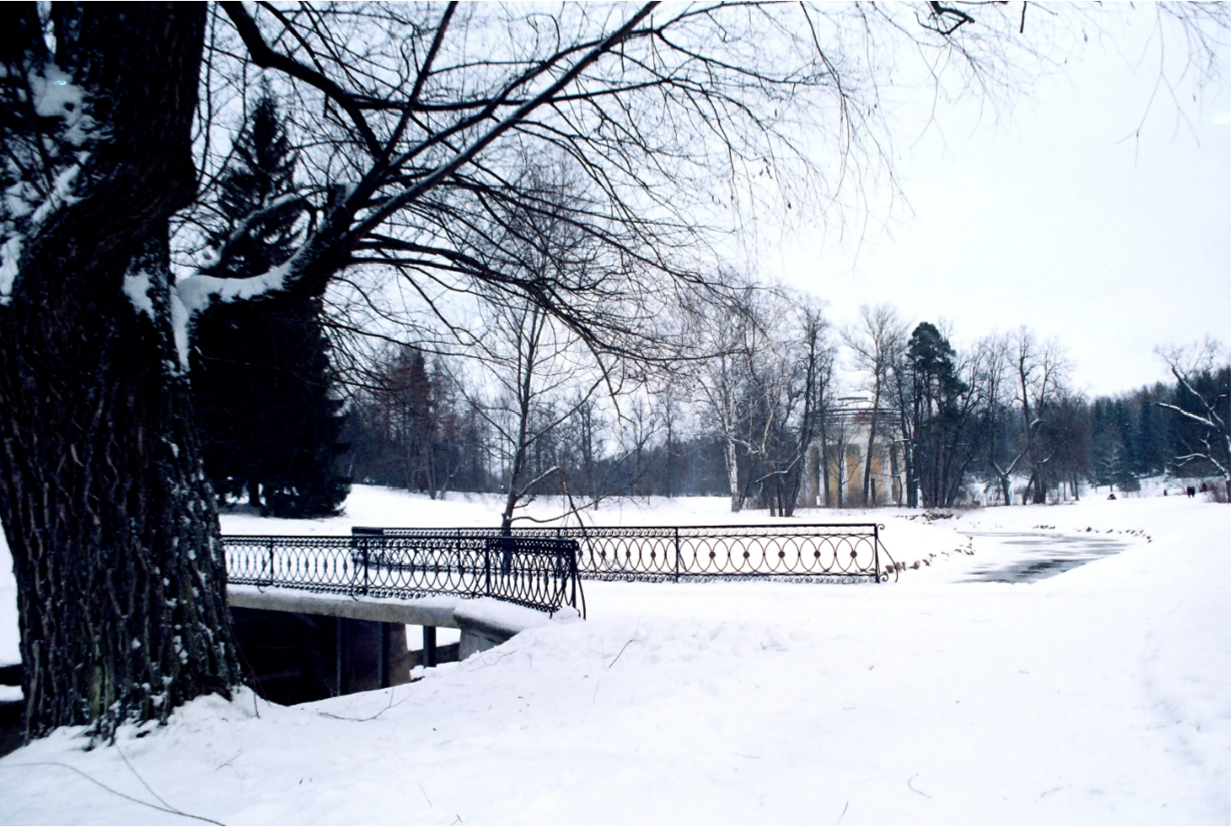
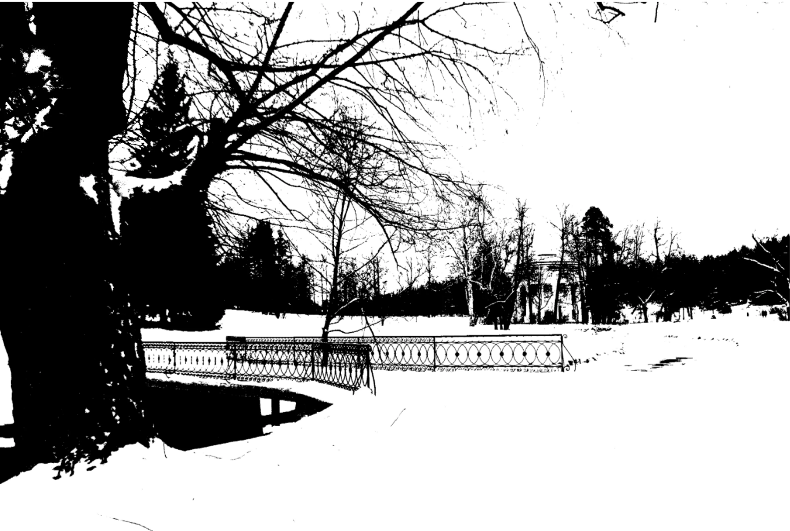
Image Thresholding

Slide 5
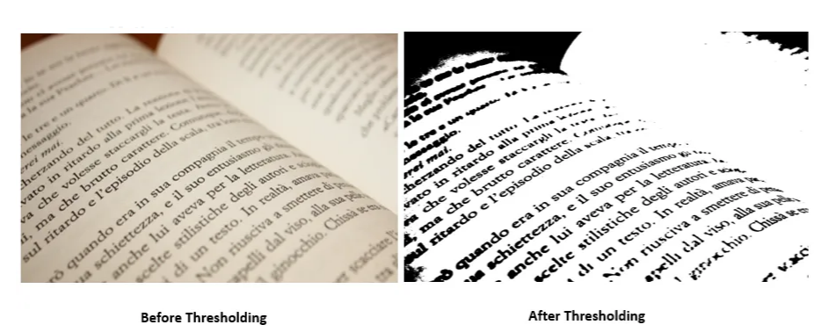
Image Thresholding
Converting Grey-Scale image to a binary image to extract more information.
By dividing an image into distinct regions based on pixel intensity or pixel value.

Slide 6
Edge Detection

Slide 7

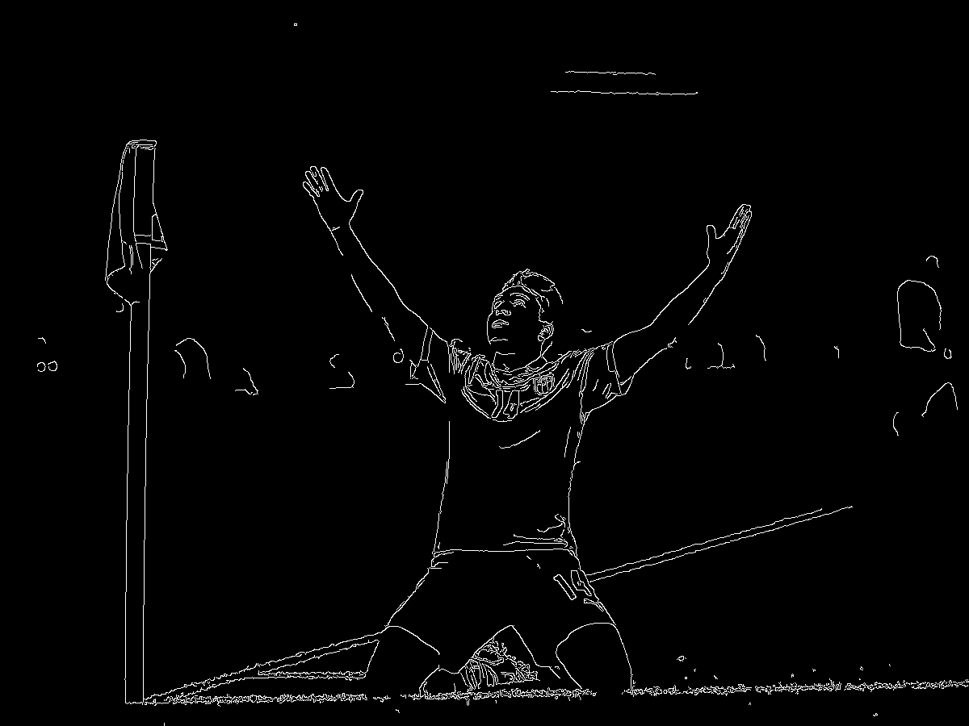
Edge Detection

Slide 8
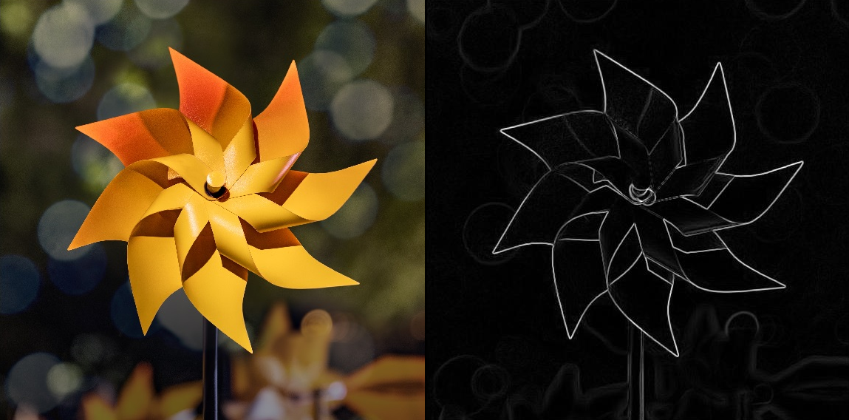
Edge Detection
Edge detection is an image processing technique for identifying the boundaries of objects in an image.
This is achieved by analyzing the changes in intensity between neighboring pixels.

Slide 9
Contours

Slide 10
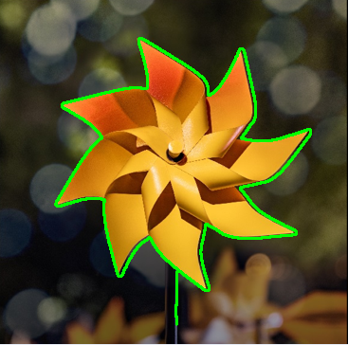
Contours
Contours represent the complete boundaries of objects in an image.
These boundaries are formed by connecting previously identified edges.
By analyzing contours, we can extract features like size, shape, and perimeter

Slide 11
HSV Color Space

Slide 12
(Hue, Saturation, Value)
HSV
Hue: Represents the actual color itself.
Saturation: Represents the intensity or purity of the color.
Value: Represents the brightness of the color.
Increase saturation (More Vibrant Color)
Decrease saturation (More Gray Color)
Increase Value (Brighter image)
Decrease Value (Darker image)

Slide 13
MediaPipe Library

Slide 14
Thank You !!

